Slide 1
Project Management:
Process, Technology, and Practice
Ganesh Vaidyanathan
Chapter 11
Project Organizational Structures

Slide 2
Learning objectives
Define authority, reliability, responsibility, and accountability in projects
Identify, define, and organize the five organizational structures
Design projects aligned with organizational strategy
Work with the project management office, and understand how PMOs function
Discuss general policies and procedures of PM
Understand individuals and project team roles and build project teams
Understand the risks, and manage outsourcing projects

Slide 3
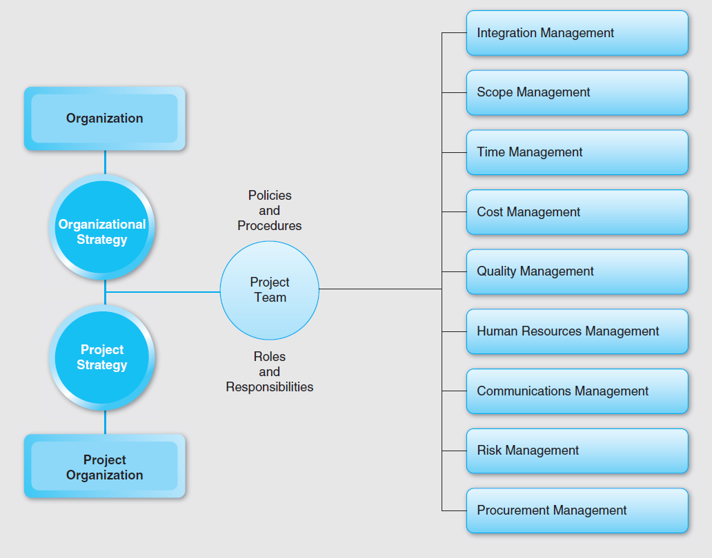

Slide 4
Fayol’s principles of management
Project manager needs authority to give orders and power to exact obedience in order to manage projects successfully
Project manager needs the discipline not to misuse the authority and power.
The interest of any one individual employee shall not supersede the entire organization’s interests
Fair pay and rewards for rendered services
All materials and people must be in appointed places for a project
Fair and equal treatment amongst team members and project managers
A stable project team with no or very limited turnover of personnel
Harmony and union among personnel

Slide 5
4 legged chair of an organizational structure
Authority is a manager’s right to make decisions, issue orders, and allocate resources to achieve desired outcome.
Accountability in organizations deals with the reporting and justification of the project outcomes to superiors.
Reliability is the degree to which a project team member can be depended upon to ensure the success of the project with a sound and consistent effort.
Responsibility is less formal and is an externally imposed duty with a felt sense of obligation.

Slide 6
Authority
Formal Authority |  | Functional Authority
Legitimacy | Position | Competence | Person
Legal Legal order Social approval | Hierarchical office Formally conferred Authority of sanctions Role incumbency Formal role or position | Rational authority Technical knowledge and expertise Experience Specialized skills Authority of confidence Knowledge of performance criteria | Traditional authority Charismatic Conferred by seniority or popularity Techniques of persuasion Knowledge of human aspect of administration Rapport with subordinates Ability to mediate individual needs

Slide 7
Organizational Structures
Organizations can be classified into five major structures:
Functional structure
Departmental structure
Matrix structure
Flat structure
Virtual structure

Slide 8
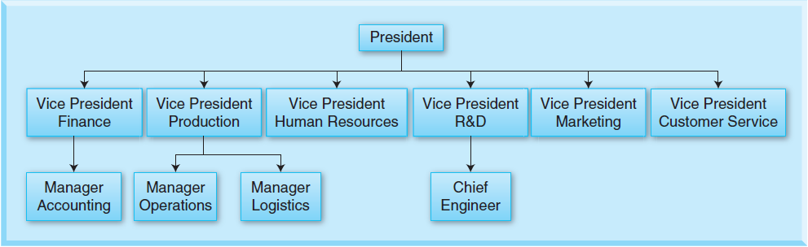
Functional Structure

Slide 9
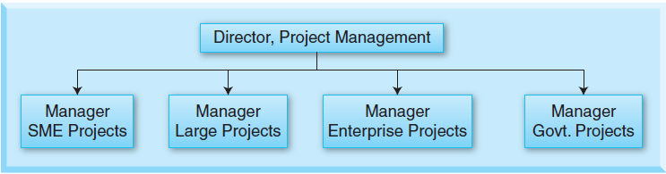
Departmental Structure

Slide 10
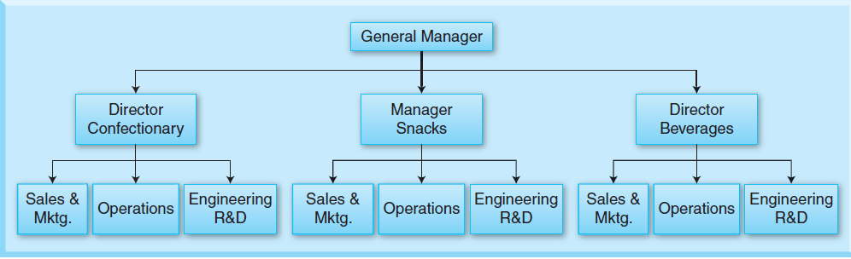
Departmental Structure

Slide 11
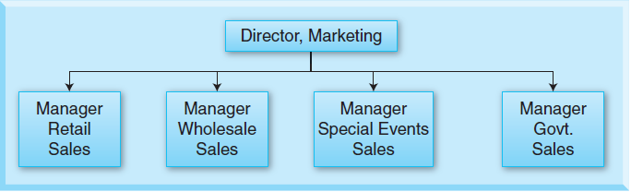
Departmental Structure

Slide 12
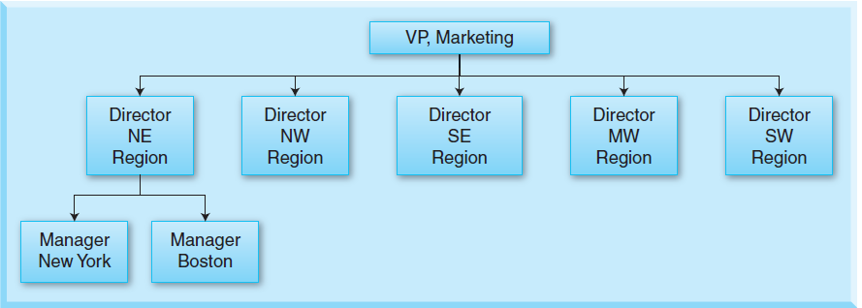
Departmental Structure

Slide 13
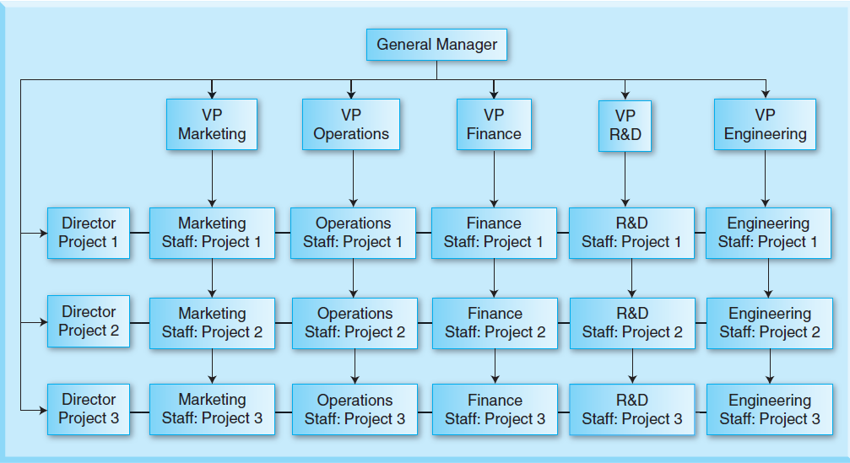
Matrix Structure
Weak, Strong, and Balanced Matrix: Functional, Project, and Both

Slide 14
Flat Structure
A flat structure is common in professional organizations like law firms, consulting firms, entrepreneurial start-ups, and small companies in general.
As the company grows, however, the organization becomes more complex and hierarchical, which leads to an expanded structure, with more levels and departments.
A flat project organization has few or no levels of intervening management between staff and managers.

Slide 15
Virtual Structure
A virtual organization is a temporary network or loose coalition of people who come together for a specific business purpose and then disassemble when the purpose has been met.
“Virtual” originates from the virtual memory of computers, the ability to appear to have more storage capacity than it actually has.

Slide 16
Matrix Structure
Form | Determinants
Function | When efficiency is the first criterion When competitive advantage is along a single parameter like technology, price, performance, or delivery When markets are relatively predictable When range of products with long time horizons is projected
Project | When several simultaneous success criteria like performance, cost, schedule, technology, and efficiency are considered When moderate market changes are expected When there are many different clients, markets, products, or projects When there is specified time for each client or project

Slide 17
When and What Matrix Structure Should be Used?
Factors | Favors Functional Structure | Favors Dept. Structure | Favors Matrix Structure
Uncertainty | Low | High | High
Complexity | Low | Medium | High
Duration | Short | Medium | Long
Size | Small | Medium | Large
Importance | Low | Medium | High
Customer | Diverse | Medium | One
Interdependency from within Structure | Low | Medium | High
Interdependency between Structure | High | Medium | Low
Time Criticality | Low | Medium | High
Differentiation | Low | High | Medium

Slide 18
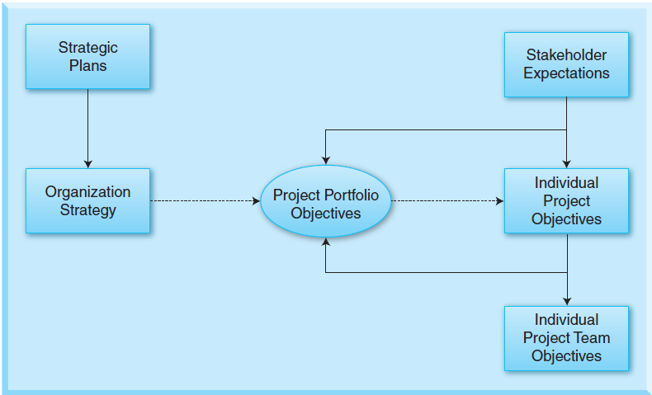
Organizational and Project Strategy
Projects in an organization have to be strategized and the organizational strategies have to be aligned with those project strategies

Slide 19
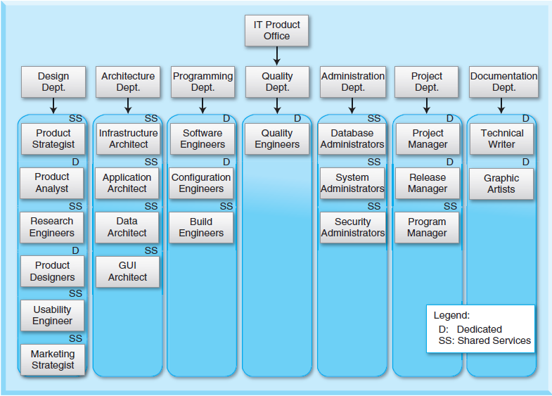
MIS Project Structure

Slide 20

PMO
Many organizations are moving in the direction of establishing PMOs or have already done so.
There is strong evidence that PM standards and methods are most highly correlated with project performance.
The use of project historical archives also showed a significant correlation with project performance.
Pioneers in establishing PMOs are providing information and advice on essential policies and documents that should accompany the establishment and use of a PMO.

Slide 21
PMO Office
Project support: Provide project management guidance to project managers in business units
Project management process/methodology: Develop and implement a consistent and standardized process
Training: Conduct training programs or collect requirements for an outside company
Home for project managers: Maintain a centralized office from which project managers are loaned out to work on projects
Internal consulting and mentoring: Advise employees about best practices

Slide 22
PMO Office
Project management software tools: Select and maintain project management tools for use by employees
Portfolio management: Establish a staff of program managers who can manage multiple projects that are related, such as infrastructure technologies, desktop applications and so on, and allocate resources accordingly
Project Control: Establish control processes and monitor projects

Slide 23
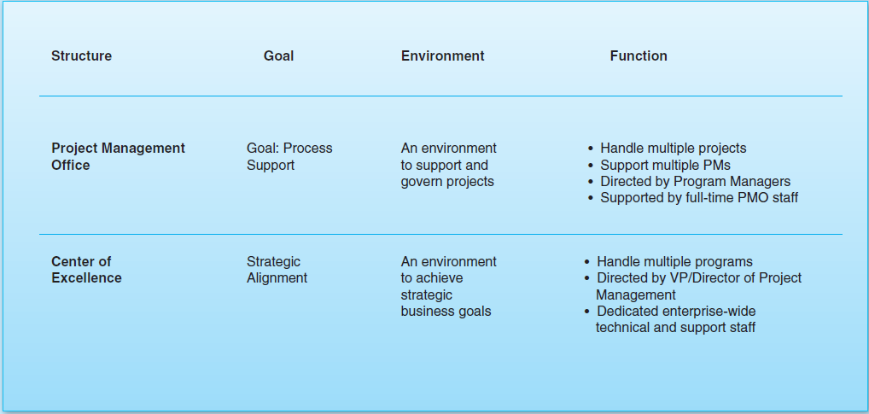
PMO

Slide 24
Policies and Procedures
Policies reflect the "rules" governing the implementation of the project management processes.
Procedures, on the other hand, represent an implementation of policy and should evolve over time as new tools emerge, new processes are designed, and the risks associated with an area changes in response to internal or external environmental changes.
Project organizations need to challenge outdated procedures and revise them as and when needed.
The general policies and procedures as well as guidelines need to be in a document that is accessible to all stakeholders of a project.

Slide 25
General Policies
Policy 1: Establish Organizational Objectives
Policy 2: Include Project Responsibilities in Job Descriptions
Policy 3: Increase Use of Team-Based Performance Reviews
Policy 4: Establish Career Paths for Program and Project Personnel
Policy 5: Organize Programs Into Projects and Subprojects
Policy 6: Prioritize Using Project Inventories
Policy 7: Optimize Personnel Resources
Policy 8: Coordinate Intergroup Transitions

Slide 26
Roles and Responsibilities
Role | Responsibility | Skills Needed
Project Manager | Plan and schedule activities Coordinate all activities Control success factors Measure all project metrics | Planning Coordination Managing activities Conflict resolution Leadership People skills
Project Advisor | Understand technology and business Analyze project requirements and select activities based on facts | Technical expertise Business acumen Assessing trade-offs Decision making
Project Communicator | Communicate with all stakeholders Report to stakeholders Negotiate with contractors and vendors | Excellent communications Negotiation Leadership People skills

Slide 27
Project Team Roles
Group task roles
Team member roles are related to their project. Their purpose is to facilitate and coordinate team effort in the selection, definition, and solution to the problem of the project.
Group building and maintenance roles
The roles in this classification are oriented towards the function of the team. The roles can alter or maintain the team way of working to strengthen, regulate, and perpetuate the team as a team.

Slide 28
Project Team Roles
Individual roles
This classification of roles is directed towards the satisfaction of individual needs of each of the team members. Individual team members with their own goals not relevant to the project tasks are relevant to the problem of group dynamics, training, and improving team maturity and project efficiency.

Slide 29
Group Task Roles
Initiator-Contributor
Information Seeker
Opinion Seeker
Information Giver
Opinion Giver
Elaborator
Coordinator
Orienter
Evaluator-Critic
Energizer
Procedural Technician

Slide 30
Group building and maintenance roles
Encourager
Harmonizer
Compromiser
Gatekeeper-Expediter
Standard setter or ego ideal
Observer-Commentator
Follower

Slide 31
Individualistic Roles
Aggressor
Blocker
Recognition Seeker
Self-confessor
Playboy/Playgirl
Dominator
Help Seeker
Special Interest Pleader

Slide 32
Team Building
Category | Factors of effective team building
Objectives | Purpose of project Expectations of stakeholders
Project Outcome | Expected results and outcome Tools and techniques to be used to obtain results Metrics and measurements Methods of measuring the metrics
Authority, Reliability, Responsibility, and Accountability | Authority and accountability structure Organizational structure Responsibility matrix
Resources | Required expertise Required skills Required technology Required consultants and contractors Mentorship Rewards and recognition

Slide 33
Team Building
Category | Factors of effective team building
Teamwork | Expectations of each team member Decision-making process Tools for effective consensus building Effective technology transfer Learning Effective communications
Four stages in the project lifespan:
Forming
Storming
Norming
Performing

Slide 34
Outsourcing
Offshoring is the process of outsourcing a project to another country which is outside of the country and usually to a location off the shores of the country.
Nearshoring is the process of outsourcing a project to another company in a nearby location, state or country that shares a border with the country with the outsourcing organization.
Insourcing is when a business unit does not have certain skills and so uses the skills from other departments internal to the organization.

Slide 35
Outsourcing
Cosourcing in a project is a practice when the project is performed by internal staff of an organization and also by an external contractor. It is often advantageous to an organization as it minimizes outsourcing risks and brings control over the outsourced project.
Multisourcing is a new outsourcing model that reaches out to bring multiple sources from both inside and outside an organization. For example, ABN AMRO is partnered with three different Indian companies Infosys, Patni and TCS along with two American companies Accenture and IBM.

Slide 36
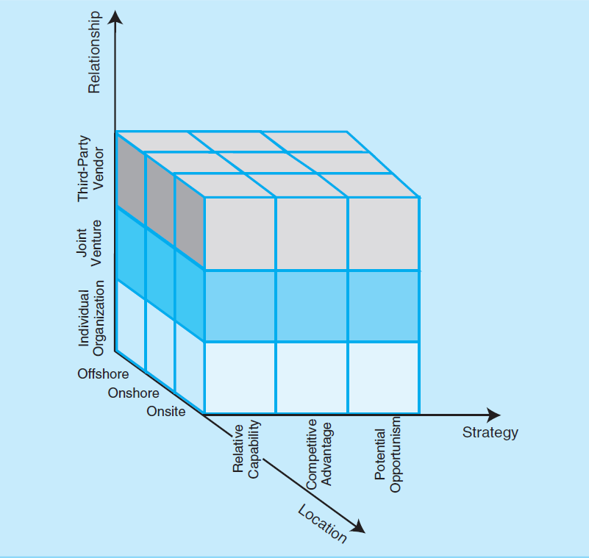
3 Dimensions of Outsourcing

Slide 37
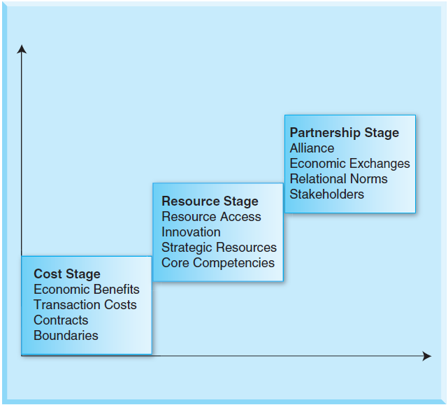
Maturity in Outsourcing

Slide 38
Best Practices of Outsourcing
Selection of projects
Selection of outsourcing company
Project requirements
Delivery and documentation of projects
Hidden costs
Project control
Personnel issues
Knowledge transfer
Conflict management
Communication management
Relationships
Contracts and Exit strategy

Slide 39
Summary
Authority is a manager’s right to make decisions, issue orders, and allocate resources to achieve desired outcome.
Responsibility is less formal and is an externally imposed duty with a felt sense of obligation.
Accountability in organizations deals with the reporting and justification of the project outcomes to superiors.
Reliability refers to moral qualities and also putting up the best effort to accomplish an assigned task using the best judgment, knowledge, skill, and habit.

Slide 40
Summary
Organizations can be classified into five major structures: functional structure, departmental structure, matrix structure, flat structure, and virtual structure. Each of these organizational structures has its advantages and disadvantages that depend upon how these structures facilitate or impede decision-making abilities, their relationships, their communication channels, and how they lead to successful projects.
Based on the role of the functional managers and project leaders, the matrix structure can be categorized as a weak, a strong, or a balanced structure as seen by the project manager.
An organization’s strategy has to be linked with its portfolio of projects.

Slide 41
Summary
A portfolio of projects is a set of projects that are managed in a coordinated effort to deliver maximum benefits in an organization.
The project strategies linked to an organization strategy are then linked to the strategic planning of individual projects, their objectives, and their strategies in all phases of the project. These are aligned with the team and team member strategies as well.
Organizations can be either mature or immature. In an immature organization, the project processes are generally improvised by the project teams and their management during the progress of the project. In contrast, a mature organization has the ability to manage projects effectively using its processes.

Slide 42
Summary
The knowledge gained from various projects and the manner in which projects were successfully carried are the intellectual property of organizations.
Project management process in an organization needs to be managed to use the knowledge gained from past projects in future projects.
The PMO exists to assist project managers, teams, and various management levels on strategic matters and functional entities throughout the organization in implementing project management principles, practices, methodologies, tools, and techniques

Slide 43
Summary
Project organizations need to challenge outdated procedures and revise them as and when needed. The general policies and procedures as well as guidelines need to be in a document that is accessible to all stakeholders of a project.
Teamwork is very important in project performance. An effective team can help a project achieve its goals. An ineffective team can cause disruption, failure in project delivery, and ultimately project failure. A team is made up of diverse people with varied cultural background, technology background, expertise, socioeconomic background, emotions, behaviors, and so on. The way these varied people interact and relate to one another is an important factor in determining the success of the team and the project.

Slide 44
Summary
There are three major classifications of team member roles: group task roles, group building and maintenance roles, and individual roles.
Outsourcing is the delegation of administrative, engineering, research, development, or technical support processes to a third-party vendor at a lower-cost location. This third-party vendor may be inside or outside the country.
The driving force of outsourcing is customers who want more of everything for less money. There are other factors or drivers as well—globalization, evolution, deflation, demographics, and competition.

Slide 45
Summary
Centralization occurs in an organization when a limited amount of authority is delegated. Decentralization occurs when a significant amount of authority is delegated to lower levels in the organization.
There are a number of issues and problems with outsourcing including the selection of projects, the selection of outsourcing company, the requirements of the project, delivery and documentation of projects, hidden costs, project control, personnel issues, knowledge transfer, conflict management, communication management, contracts, relationships, and an exit strategy

Slide 46
Class Discussions
Projects need not have an organizational structure.
Formal authority is better than functional authority.
Responsibility and reliability are very personal and hard to define in projects.
There is no one good organizational structure for construction projects.
There is no one good organizational structure for new product development projects.
There is no one good organizational structure for MIS projects.
You need a PMO for even small projects.
Outsourcing is the beginning of sending jobs out of the country.
Big companies should not outsource as they can afford to hire required resources.
Outsourcing should be only in terms of a strategic partnership.

Slide 47
